Slide 1
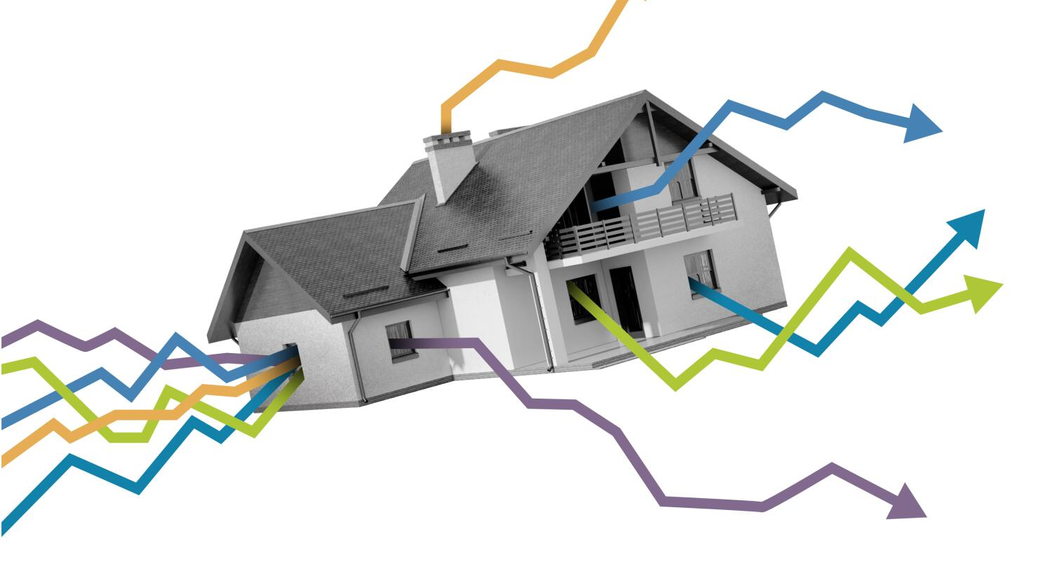
Predicting House Prices using advanced regression techniques
ABDULAZEEZ SALIU

Slide 2
AGENDA
Introduction
Exploratory Data analysis
Linear Regression Model
Business recommendation

Slide 3
Introduction: The real estate market is complex and ever-changing, with various factors impacting home prices. Accurately predicting these prices is essential for buyers, sellers, real estate agents, and investors. The House Price Prediction Model is designed to offer reliable price estimates based on a comprehensive set of features, enabling real estate companies to accurately value properties for sale.

Slide 4
Problem Statement: Accurately predicting house prices is a significant challenge in the real estate market, shaped by numerous factors like dwelling types, zoning classifications, lot features, property conditions, and sale conditions. Traditional property valuation methods often depend on limited data and subjective judgments, leading to inconsistencies and inaccuracies. This uncertainty can impact various stakeholders, including home buyers, sellers, real estate agents, and investors, potentially causing financial losses and inefficiencies for the real estate company.

Slide 5
Exploratory data analysis

Slide 6
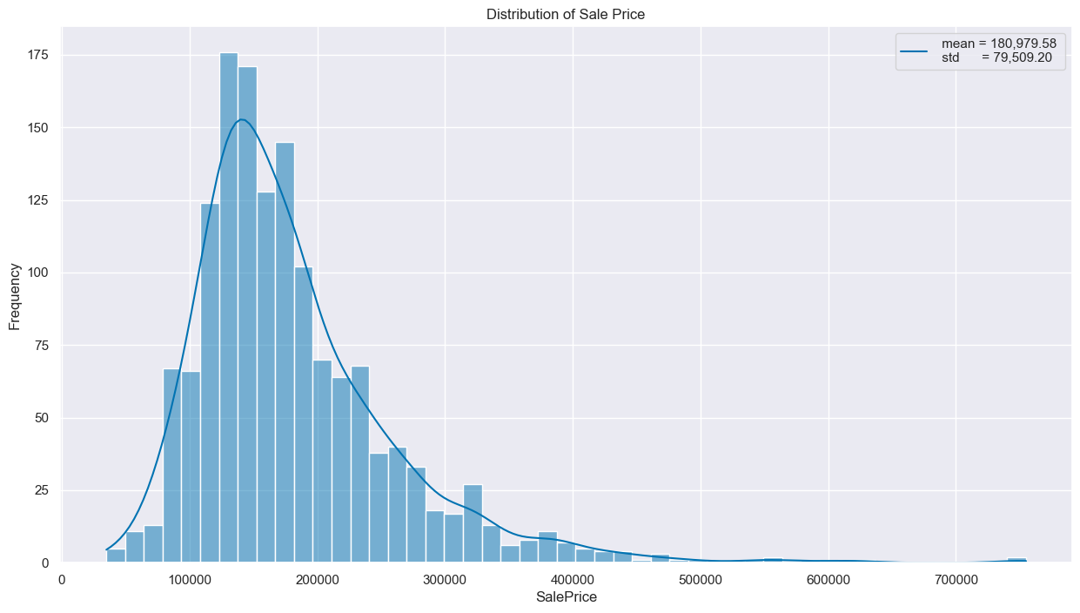
Target variable

Slide 7
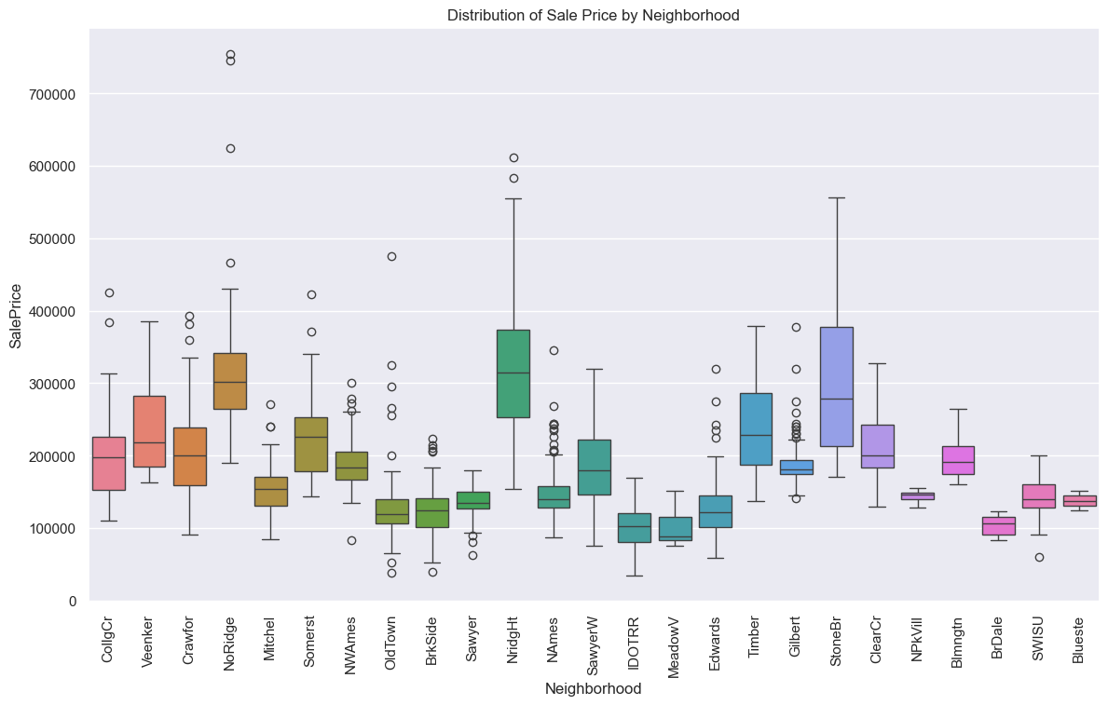
FEATURES`

Slide 8
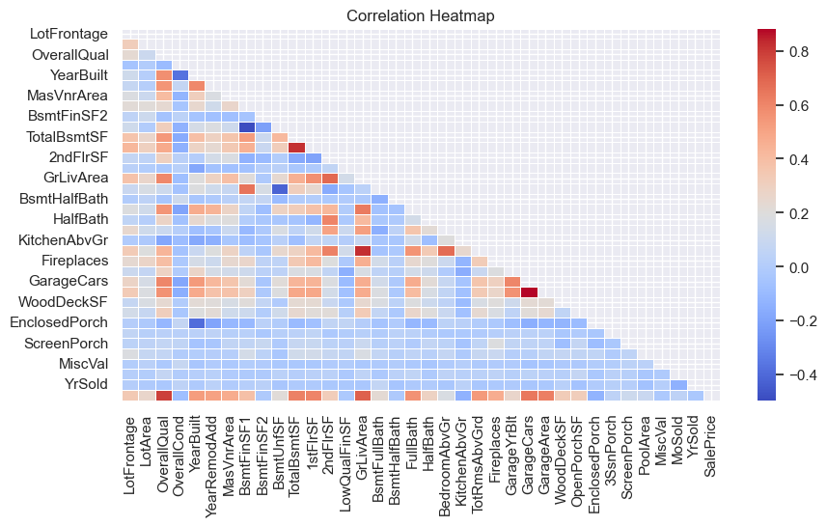

Slide 9
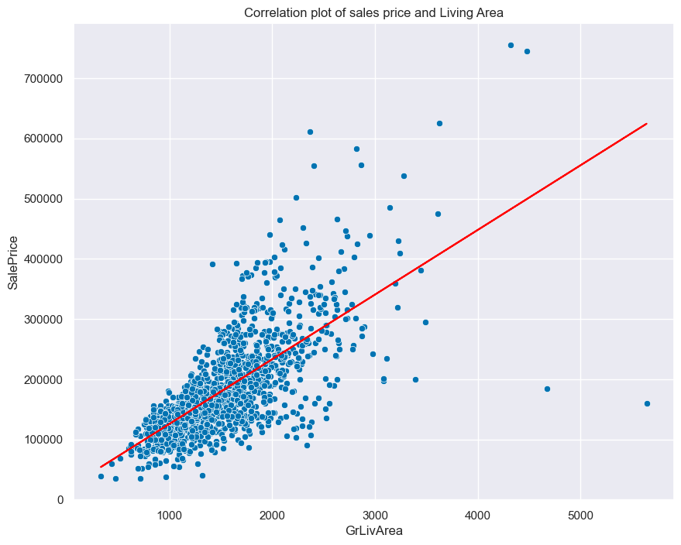

Slide 10
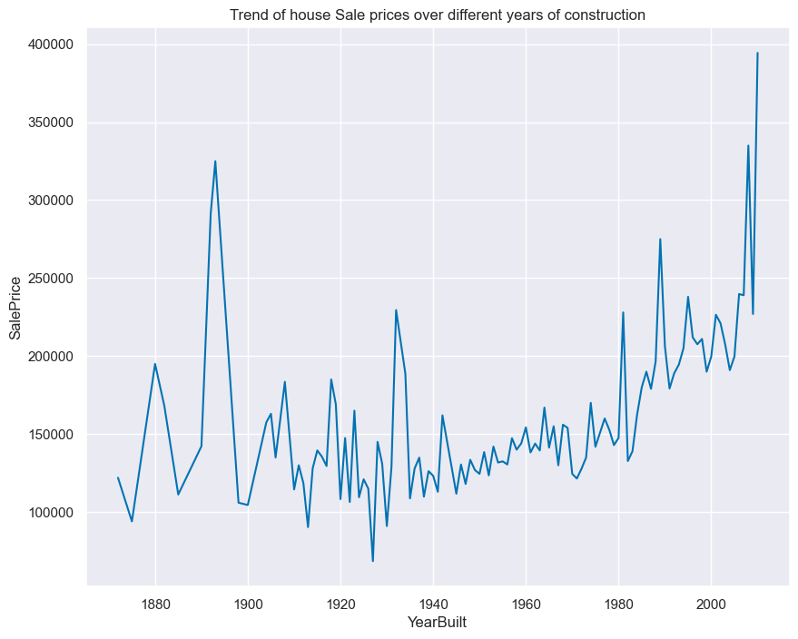

Slide 11
Insights
Summary of Insights from EDA on Sale Prices
- Sale Price Distribution
The sale prices of houses range from $34,900 to $755,000, with an average price of $180,979 and a median of $163,000. Most houses are priced below $200,000, although there is a significant number of outliers at higher prices.
- Neighborhood Influence
Neighbourhoods such as NridgHt, NoRidge, and StoneBr consistently appear as high-price areas, while MeadowV, IDOTRR, and BrDale are associated with lower prices.
- Historical and Seasonal Trends
House sale prices have generally increased over time, with noticeable peaks around the early 1900s and a significant upward trend toward the year 2000. This reflects historical market trends and possibly improvements in construction quality and amenities. Additionally, house prices show seasonal variations, with lower prices in January, a peak in February, a dip in April, and the highest prices typically occurring in September. These trends can help both buyers and sellers determine the best time of year to buy or sell properties.

Slide 12
LINEAR REGRESSION MODEL (XGBOOST)

Slide 13
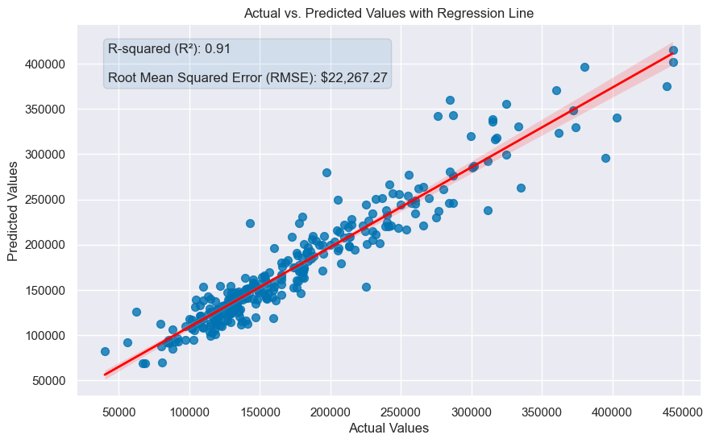

Slide 14
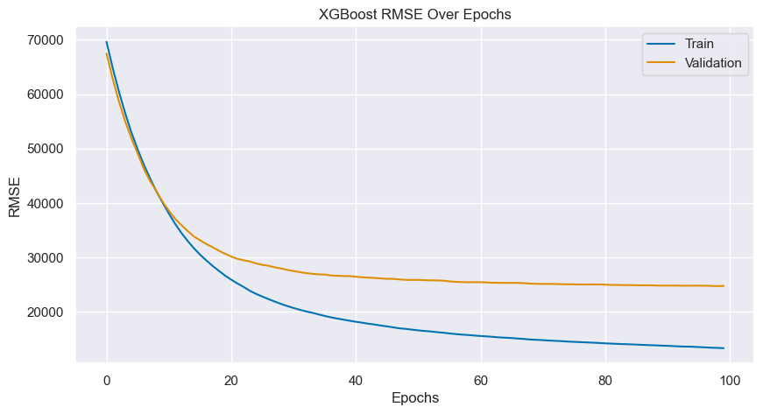

Slide 15
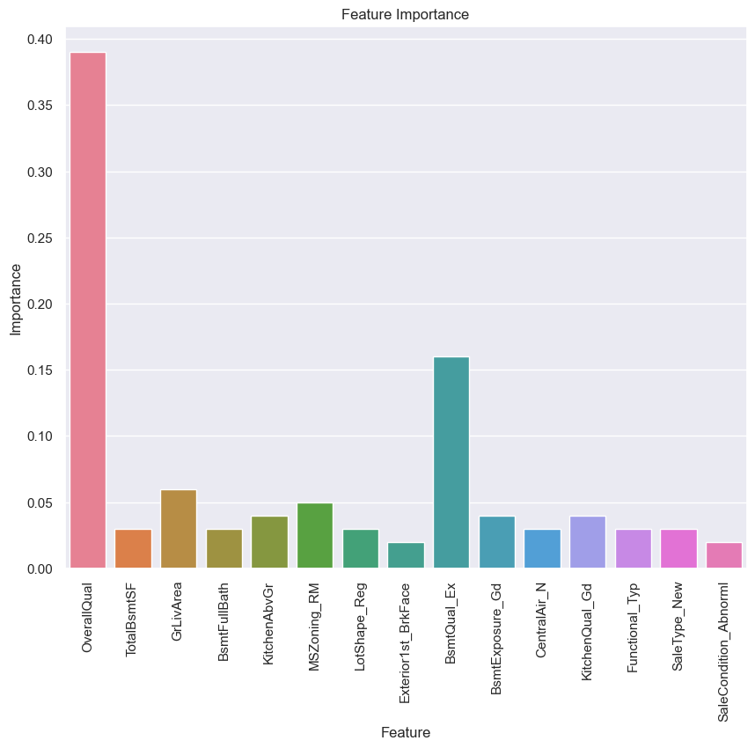

Slide 16
BUSINESS RECOMMENDATIONS

Slide 17
Business Recommendations
To effectively predict house prices and achieve a minimum accuracy of 85% and RMSE of $25,000, the real estate company should focus on the following recommendations for model deployment:
- Track Model Accuracy:
Regularly monitor the accuracy score of the model’s predictions to assess the variance between the predicted and actual sale prices. This will help in managing the error in quoted sale prices.
- Set a Target RMSE:
Given that the XGBoost model currently has an RMSE of $23,232 and r-squared of 91%, it’s advisable to set a target RMSE around $25,000. This target accounts for potential overfitting and changes in data trends once the model is in use.
- Adjust Based on Performance:
As data collection continues and the model’s performance is evaluated in real-world scenarios, adjust the RMSE target as needed. If the model consistently meets or exceeds the current target, consider raising the target to align with advancements in model accuracy or evolving business needs.

Slide 18
THANK YOU

